Slide 1

Assessment Report on the
Sustainable Use of Wild Species
www.ipbes.net
The Intergovernmental Science-Policy Platform
on Biodiversity & Ecosystem Services
#SustainableUse Assessment

Slide 2


Why is this assessment important
1.

Slide 3






50,000 Wild Species Meet Needs of Billions Worldwide
Experts Offer Options to Ensure Sustainable Use
1 in 5 People Rely on Wild Species for Income & Food
>10,000 Wild Species Harvested for Human Food
2.4 Billion People (1 in 3) Depend on Fuel Wood for Cooking

Slide 4
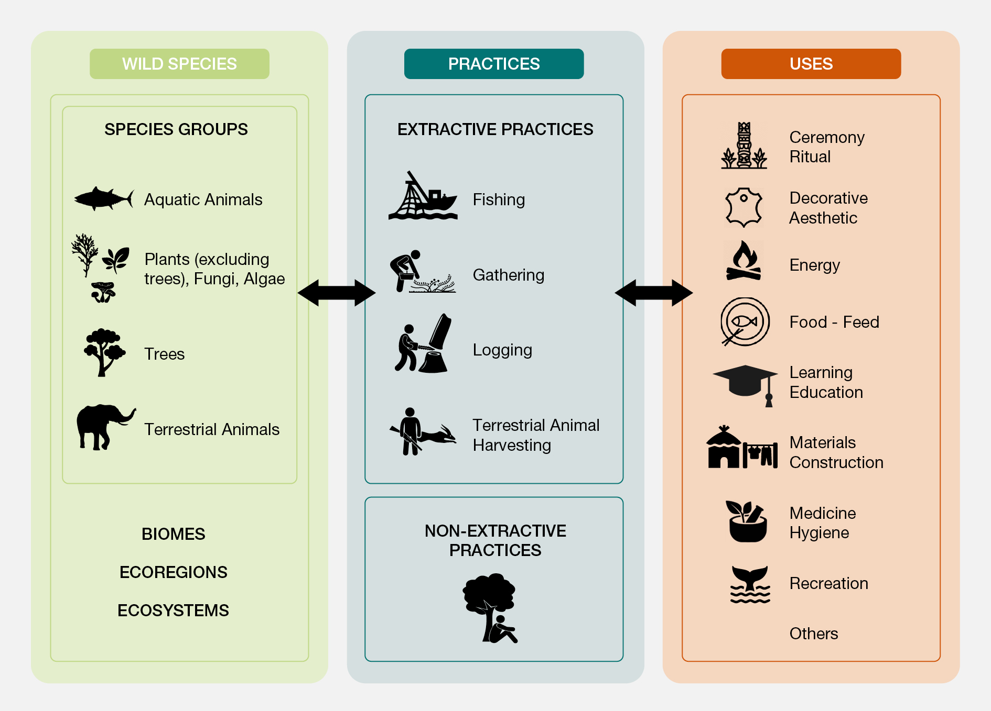
Describes the diverse uses of wild species
and associated practices

Slide 5
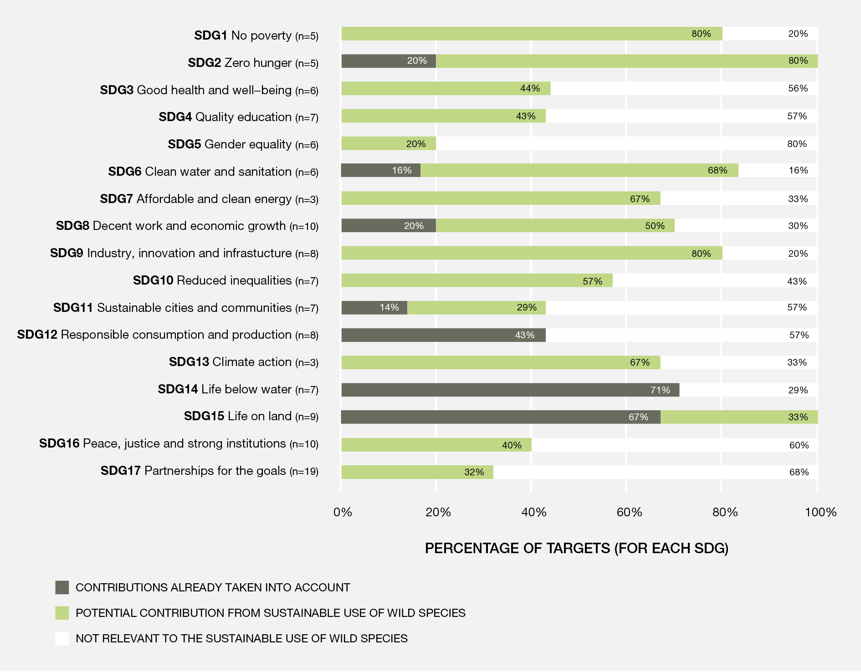
Explores what ‘sustainable use’ entails and how it relates to the UN Sustainable Development Goals

Slide 6
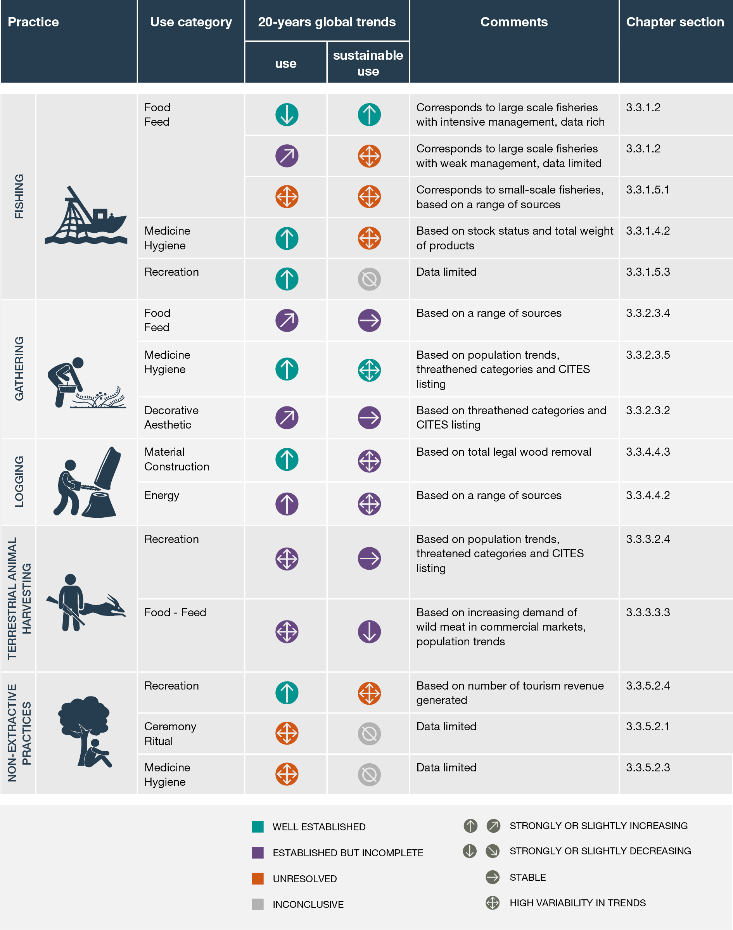
Assess status and trends in the use of wild species

Slide 7
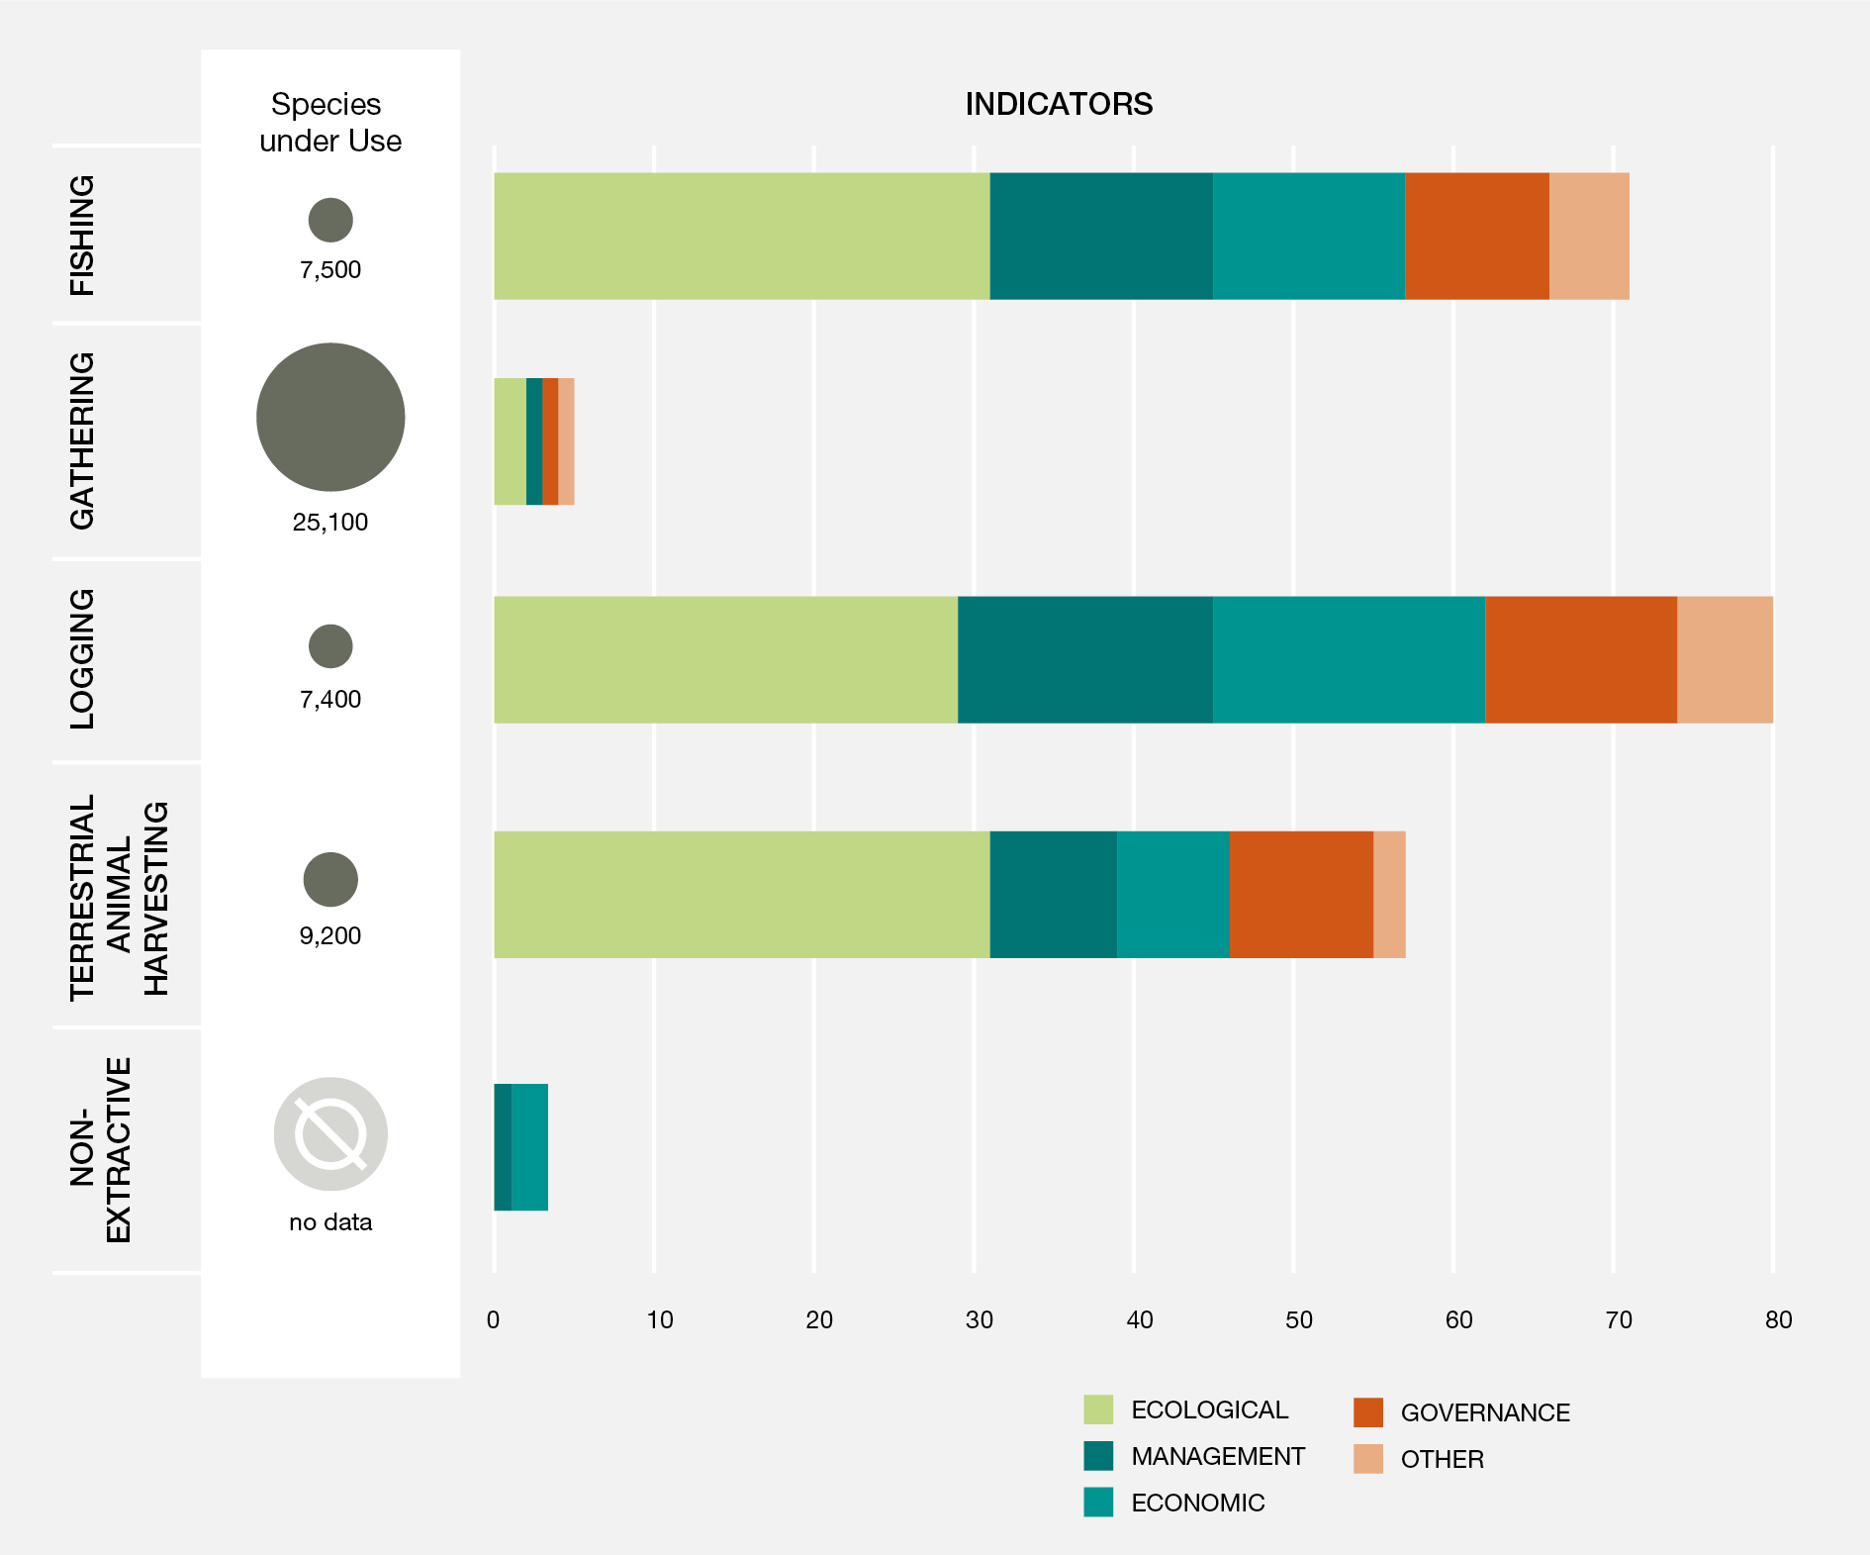
Assess
status and trends
in the use
of wild species

Slide 8
Identifies the environmental and social drivers that enhance or undermine the sustainability of use
Environmental drivers such as climate change, pollution and invasive alien species impact the abundance and distribution of wild species
Global trade in wild species is a major driver and has expanded substantially over the past 40 years
Illegal harvesting and trade in wild species involves numerous species and is the third largest class of illegal trade
Lack of attention to gender and equitable distribution of costs and benefits undermine the sustainability of use
Effective governance, institutions, education and public awareness can promote positive outcomes and mitigate negative impacts

Slide 9
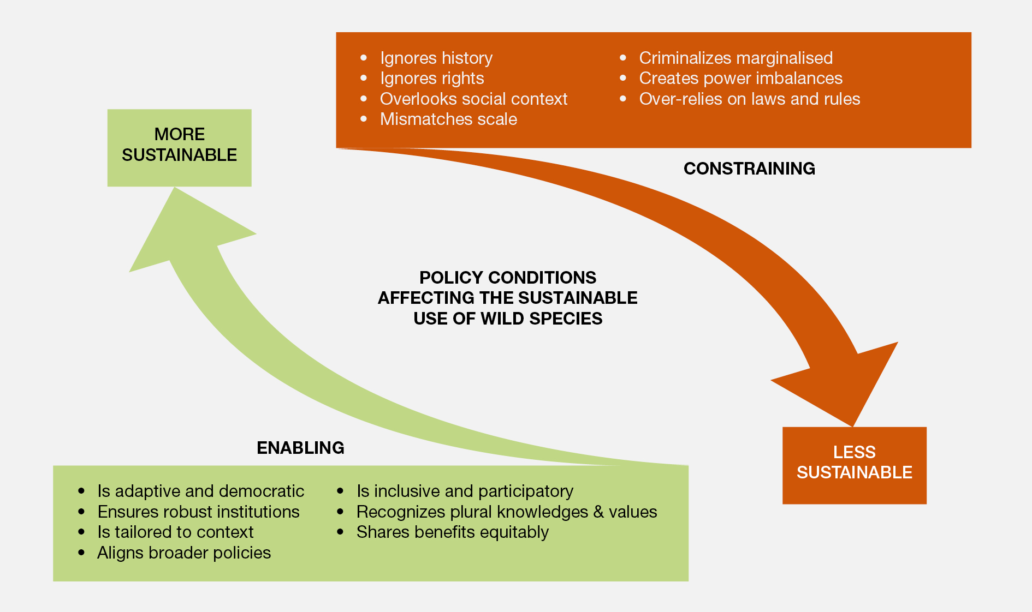
Identifies policy options & enabling conditions for sustainable use from national to global scales

Slide 10
Identifies 7 key elements & policy options
to strenghten sustainable use of wild species
Strengthen inclusive and participatory decision-making
Recognize and support multiple forms of knowledge
Ensure fair and equitable distribution of costs and benefits
Tailor policies to specific context
Monitor wild species and practices
Align policies at international, national, regional and local levels
Support robust institutions, including customary institutions

Slide 11

The summary for policymakers
2.

Slide 12
  Policy relevant key messages
  Background information
Four sections:
Sustainable use of wild species is critical for people and nature
Status and trends in the use of wild species
Key elements and conditions for the sustainable use of wild species
Pathways and levers to promote sustainable use and enhance the sustainability of the use of wild species in a dynamic future

Slide 13
Key messages A - Sustainable use of wild species is critical for people and nature
A.1 Billions of people in all regions of the world rely on and benefit from the use of wild species for food, medicine, energy, income and many other purposes.
A.2 Sustainable use of wild species is central to the identity and existence of many IPLCs.
A.3 Ensuring sustainability of the use of wild species, including inter alia by promoting the sustainable use and halting overexploitation, is critical to reverse the global trend in biodiversity decline.

Slide 14
Key messages B - Status and trends in the use of wild species
B.1 Status and trends in the uses of wild species vary depending on types and scales of use, and social ecological contexts.
B.2 The sustainability of the use of wild species is influenced negatively or positively by multiple drivers.
B.3 Key elements of sustainable use have been identified in relevant international and regional standards, agreements and certification schemes but indicators are incomplete, most notably for social components.

Slide 15
Key messages C - Key elements and conditions for the sustainable use of wild species
C.1 Policy instruments and tools are most successful when tailored to the social and ecological contexts and when they support fairness, rights and equity.
C.2 Policy instruments and tools are more effective when they are supported by robust and adaptive institutions and are aligned across sectors and scales. Inclusive, participatory mechanisms enhance the adaptive capacity of policy instruments.
C.3 Effective monitoring of social, economic, and ecological outcomes supports better decision-making. Scientific evidence is often limited, and ILK is underutilized and undervalued.

Slide 16
Key messages C - Pathways and levers to promote sustainable use and enhance the sustainability of the use of wild species in a dynamic future
D.1 Sustainable use in the future is likely to be challenged by:
climate change
increasing demand
technological advances
Addressing these challenges will require transformative changes
D.2 Concerted interventions will be needed to implement and scale-up policy actions
D.3 The world is dynamic and therefore sustainable use requires:
constant negotiation and adaptive management
a common vision of sustainable use
transformative change in the human-nature relationship

Slide 17
Knowledge gaps identified in…
… Data and information availability and access (i.e., indicators on the social components of the use of wild species, databases on policies addressing the use of wild species, etc.)
… Assessment methods, models and scenarios (i.e., studies on multiple knowledge systems, scenario studies on gathering, etc.)
… Indigenous and local knowledge (i.e., capacity building to monitor the use wild species, methods co-developed with IPLCs, etc.)
… Multiple uses and interactions of uses with other pressures (i.e., interactions between social and ecological components of use of wild species, etc.)
… Practices (i.e, information on the trade of plants, algae and fungi, documentation about bycatch, information on harvest of edible insects, etc.)

Slide 18

Expected impacts
3.

Slide 19
Provide best-available evidence, analysis and options for decision makers
Contribute to the work of the Convention on Biological Diversity (CBD) and support the implementation of the post-2020 global biodiversity framework
Contribute to CITES’ goal of ensuring international trade in wild species does not threaten their survival in the wild
Support implementation of the Sustainable Development Goals

Slide 20

The Sustainable Use Team
3.

Slide 21
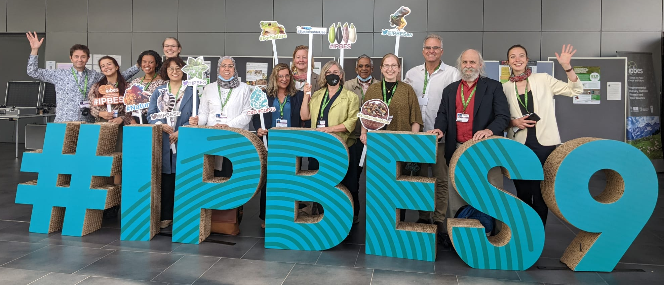
Multidisciplinary teamwork
  85 interdisciplinary experts and more than 200 contributing authors
  Natural and social scientists
Diverse knowledge sources
  Literature review: peer-reviewed and grey literature
  Indigenous and local knowledge
  Draws on more than 6,200 references

Slide 22

Thank you!
¡Gracias!
Merci!
#SustainableUse Assessment

